Slide 1

HPC Operating Committee
Spring 2019 Meeting
March 11, 2019
Meeting Called By: Kyle Mandli, Chair

Slide 2
Introduction
George Garrett
Manager, Research Computing Services
gsg8@columbia.edu
The HPC Support Team
(Research Computing Services)
hpc-support@columbia.edu

Slide 3
Agenda
HPC Clusters - Overview and Usage
Terremoto, Habanero, Yeti
HPC Updates
Challenges and Possible Solutions
Software Update
Data Center Cooling Expansion Update
Business Rules
Support Services and Training
HPC Publications Reporting
Feedback

Slide 4


High Performance Computing - Ways to Participate
Four Ways to Participate
Purchase
Rent
Free Tier
Education Tier

Slide 5
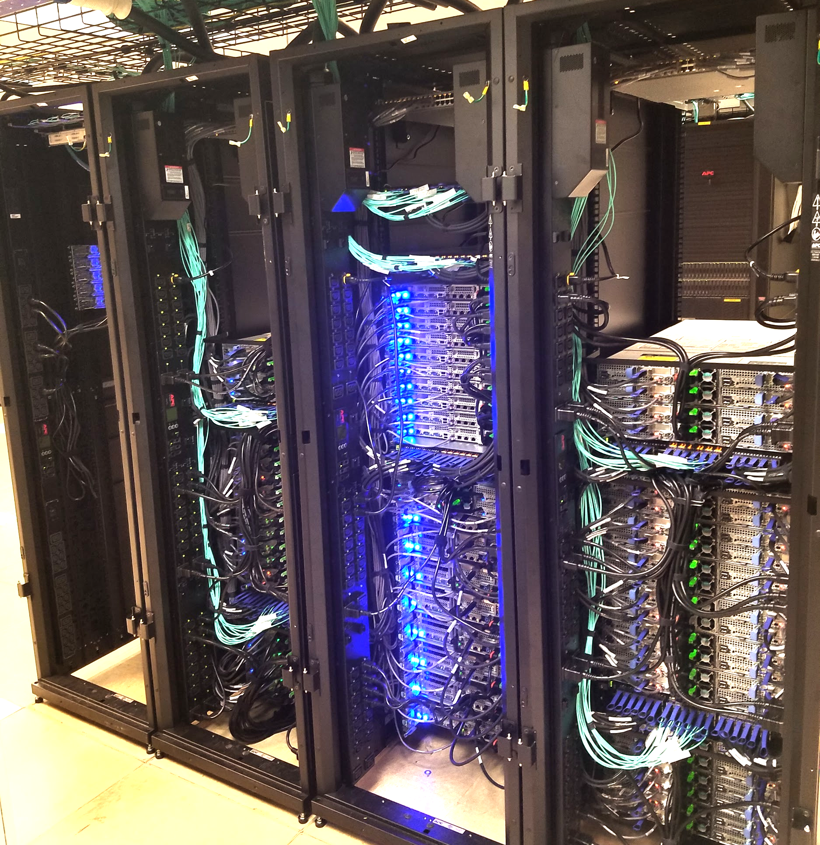
Launched in December 2018!

Slide 6
Terremoto - Participation and Usage
24 research groups
190 users
2.1 million core hours utilized
5 year lifetime

Slide 7
Terremoto - Specifications
110 Compute Nodes (2640 cores)
92 Standard nodes (192 GB)
10 High Memory nodes (768 GB)
8 GPU nodes with 2 x NVIDIA V100 GPUs
430 TB storage (Data Direct Networks GPFS GS7K)
255 TFLOPS of processing power
Dell Hardware, Dual Skylake Gold 6126 cpus, 2.6 Ghz, AVX-512
100 Gb/s EDR Infiniband, 480 GB SSD drives
Slurm job scheduler

Slide 8
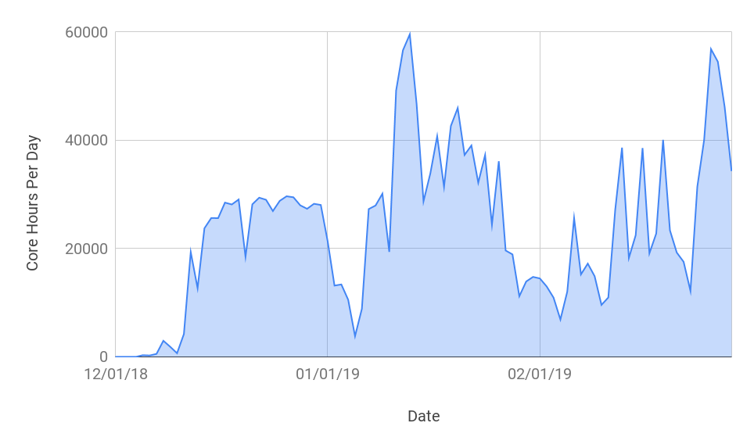
Terremoto - Cluster Usage in Core Hours
Max Theoretical Core Hours Per Day = 63,360

Slide 9
Terremoto - Job Size
Cores | 1 - 49 cores | 50 - 249 cores | 250 - 499 cores | 500 - 999 cores | 1000+ cores
Jobs | 28,274 | 173 | 10 | -- | --

Slide 10
Terremoto - Benchmarks
High Performance LINPACK (HPL) measures compute performance and is used to build the TOP500 list of supercomputers. HPL is now run automatically when our HPC nodes start up.
Terremoto CPU Gigaflops per node = 1210 Gigaflops
Skylake 2.6 Ghz CPU, AVX-512 advanced vector extensions
HPL benchmark runs 44% faster than Habanero
Rebuild your code, when possible with Intel Compiler!
Habanero CPU Gigaflops per node = 840 Gigaflops
Broadwell 2.2 Ghz CPU, AVX-2

Slide 11
Terremoto - Expansion Coming Soon
Terremoto 2019 HPC Expansion Round
In planning stages - announcement to be sent out in April
No RFP. Same CPUs as Terremoto 1st round. Newer model of GPUs.
Purchase round to commence late Spring 2019
Go-live in Late Fall 2019
If you are aware of potential demand, including new faculty recruits who may be interested, please contact us at rcs@columbia.edu

Slide 12
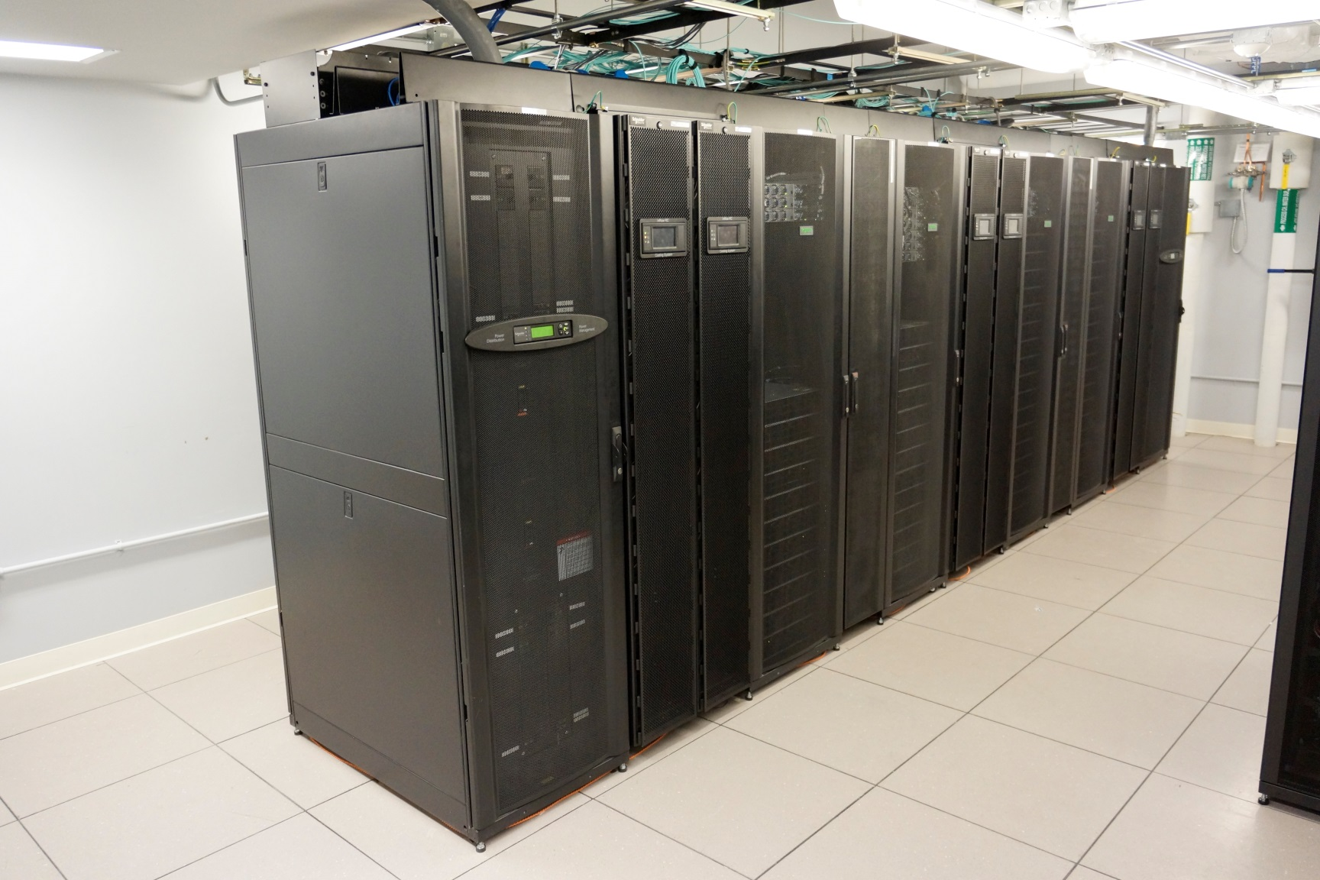
Habanero

Slide 13
Habanero - Specifications
Specs
302 nodes (7248 cores) after expansion
234 Standard servers
41 High memory servers
27 GPU servers
740 TB storage (DDN GS7K GPFS)
397 TFLOPS of processing power
Lifespan
222 nodes expire December 2020
80 nodes expire December 2021

Slide 14
Head Nodes
2 Submit nodes
Submit jobs to compute nodes
2 Data Transfer nodes (10 Gb)
scp, rdist, Globus
2 Management nodes
Bright Cluster Manager, Slurm

Slide 15

HPC - Visualization Server
Remote GUI access to Habanero storage
Reduce need to download data
Same configuration as GPU node (2 x K80)
NICE Desktop Cloud Visualization software

Slide 16
Habanero - Participation and Usage
44 groups
1,550 users
9 renters
160 free tier users
Education tier
15 courses since launch

Slide 17
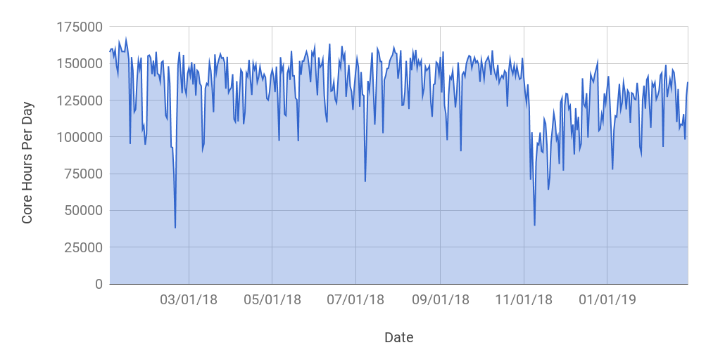
Habanero - Cluster Usage in Core Hours
Max Theoretical Core Hours Per Day = 174,528

Slide 18
Habanero - Job Size
Cores | 1 - 49 cores | 50 - 249 cores | 250 - 499 cores | 500 - 999 cores | 1000+ cores
Jobs | 777,771 | 1927 | 869 | 277 | 185

Slide 19
HPC - Recent Challenges and Possible Solutions
Complex software stacks
Time consuming to install due to many dependencies and incompatibilities with existing software
Solution: Singularity containers (see following slide)
Login node(s) occasionally overloaded
Solutions:
Training users to use Interactive Jobs or Transfer nodes
Stricter cpu, memory, and IO limits on login nodes
Remove common applications from login nodes

Slide 20

HPC Updates - Singularity containers
Singularity
Easy to use, secure containers for HPC
Supports HPC networks and accelerators (Infiniband, MPI, GPUs)
Enables reproducibility and complex software stack setup
Typical use cases
Instant deployment of complex software stacks (OpenFOAM, Genomics, Tensorflow)
Bring your own container (use on Laptop, HPC, etc.)
Available now on both Terremoto and Habanero!
$ module load singularity

Slide 21

HPC Updates - HPC Web Portal - In progress
Open OnDemand HPC Web Portal (In progress)
Supercomputing, seamlessly, open, interactive HPC via the Web.
Modernization of the HPC user experience.
Open source, NSF funded project.
Makes compute resources much more accessible to a broader audience.
https://openondemand.org
Coming Spring 2019

Slide 22

Yeti Cluster - Retired
Yeti Round 1 retired November 2017
Yeti Round 2 retired March 2019

Slide 23
Data Center Cooling Expansion Update
A&S, SEAS, EVPR, and CUIT contributed to expand Data Center cooling capacity
Data Center cooling expansion project almost complete
Expected completion Spring 2019
Assures HPC capacity for next several generations

Slide 24
Business Rules
Business rules set by HPC Operating Committee
Typically meets twice a year, open to all
Rules that require revision can be adjusted
If you have special requests, i.e. longer walltime or temporary bump in priority or resources, contact us and we will raise with the HPC OC chair as needed

Slide 25
Nodes
For each account there are three types of execute nodes
Nodes owned by the account
Nodes owned by other accounts
Public nodes

Slide 26
Nodes
Nodes owned by the account
Fewest restrictions
Priority access for node owners

Slide 27
Nodes
Nodes owned by other accounts
Most restrictions
Priority access for node owners

Slide 28
Nodes
Public nodes
Few restrictions
No priority access
Habanero Public nodes: 25 total (19 Standard, 3 High Mem, 3 GPU)
Terremoto Public nodes: 7 total (4 Standard, 1 High Mem, 2 GPU)
Notes:
Public nodes: 3 GPU nodes, 3 High Memory nodes, 19 Standard nodes

Slide 29
Job wall time limits
Your maximum wall time is 5 days on nodes your group owns and on public nodes
Your maximum wall time on other group's nodes is 12 hours

Slide 30
12 Hour Rule
If your job asks for 12 hours of walltime or less, it can run on any node
If your job asks for more than 12 hours of walltime, it can only run on nodes owned by its own account or public nodes

Slide 31
Fair share
Every job is assigned a priority
Two most important factors in priority
Target share
Recent use

Slide 32
Target Share
Determined by number of nodes owned by account
All members of account have same target share

Slide 33
Recent Use
Number of cores*hours used "recently"
Calculated at group and user level
Recent use counts for more than past use
Half-life weight currently set to two weeks

Slide 34
Job Priority
If recent use is less than target share, job priority goes up
If recent use is more than target share, job priority goes down
Recalculated every scheduling iteration

Slide 35
Business Rules
Questions regarding business rules?

Slide 36
Support Services - HPC Team
6 staff members on the HPC Team
Manager
3 Sr. Systems Engineers (System Admin and Tier 2 support)
2 Sr. Systems Analysts (Primary providers of Tier 1 support)
951 Support Ticket Requests Closed in last 12 months
Common requests: adding new users, simple and complex software installation, job scheduling and business rule inquiries

Slide 37
Support Services
Email support
hpc-support@columbia.edu

Slide 38
User Documentation
hpc.cc.columbia.edu
Click on "Terremoto documentation" or "Habanero documentation"

Slide 39
Office Hours
HPC support staff are available to answer your HPC questions in person on the first Monday of each month.
Where: North West Corner Building, Science & Eng. Library
When: 3-5 pm first Monday of the month
RSVP required: https://goo.gl/forms/v2EViPPUEXxTRMTX2

Slide 40
Workshops
Spring 2019 - Intro to HPC Workshop Series
Tue 2/26: Intro to Linux
Tue 3/5: Intro to Shell Scripting
Tue 3/12: Intro to HPC
Workshops are held in the Science & Engineering Library in the North West Corner Building.
For a listing of all upcoming events and to register, please visit:
https://rcfoundations.research.columbia.edu/

Slide 41
Group Information Sessions
HPC support staff can come and talk to your group
Topics can be general and introductory or tailored to your group.
Talk to us or contact hpc-support@columbia.edu to schedule a session.

Slide 42
Additional Workshops, Events, and Trainings
Upcoming Foundations of Research Computing Events
Including Bootcamps (Python, R, Unix, Git)
Python User group meetings (Butler Library)
Distinguished Lecture series
Research Data Services (Libraries)
Data Club (Python, R)
Map Club (GIS)

Slide 43
Support Services
Questions about support services or training?

Slide 44
HPC Publications Reporting
Research conducted on Terremoto, Habanero, Yeti, and Hotfoot machines has led to over 100 peer-reviewed publications in top-tier research journals.
Reporting publications is critical for demonstrating to University leadership the utility of supporting research computing.
To report new publications utilizing one or more of these machines, please email srcpac@columbia.edu

Slide 45
Feedback?
What feedback do you have about your experience with Habanero and/or Terremoto?

Slide 46
End of Slides
Questions?
User support: hpc-support@columbia.edu

